Slide 1
Summary of Participant Characteristics
Participant | Sex | Age (years) | Handed | Implant Hem. | Seizure Focus | Number of Blocks | Response Latency (ms)
S357 | Male | 37 | 90+ | L | L. Mesial Temporal | 108 | 1004.2 +/- 209.3
S362 | Male | 60 | 100+ | L & R | L. Post Inf. Parietal, I Frontal Pole, R. Ant Middle Frontal Gyrus | 281 | 894.7 +/- 202.4
S369 | Male | 30 | 100+ | R | R. Mesial Temporal [Parahippocampal Gyrus, Amygdala, Hippocampus, Fusiform Gyrus] | 118 | 830.3 +/- 158.7
S372 | Male | 34 | 75+ | L | L. Temporal Pole, Parahippocampal Gyrus | 144 | 860.0 +/- 121.2
S376 | Female | 49 | 90+ | R | R. Parahippocampal Gyrus | 133 | 1027.2 +/- 261.1

Slide 2
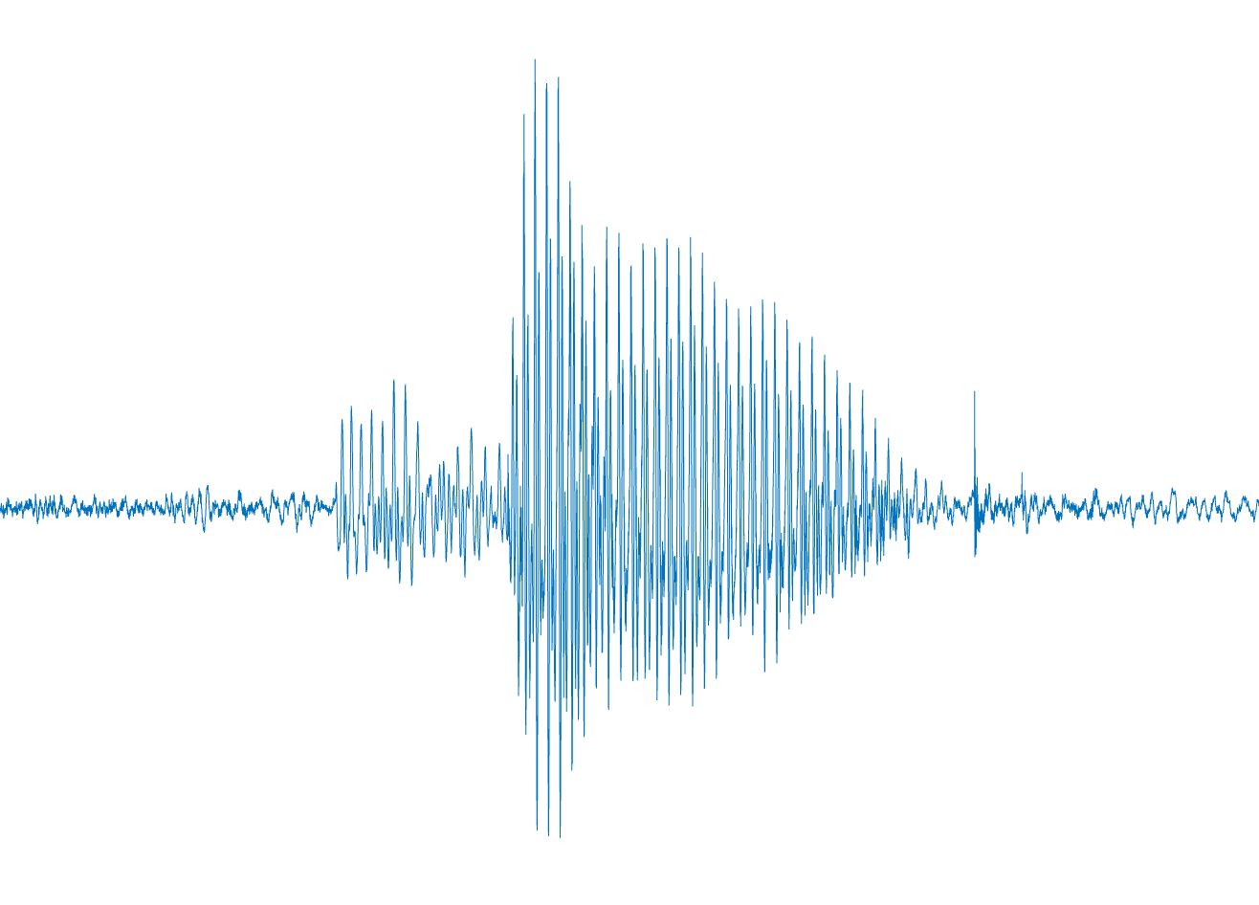
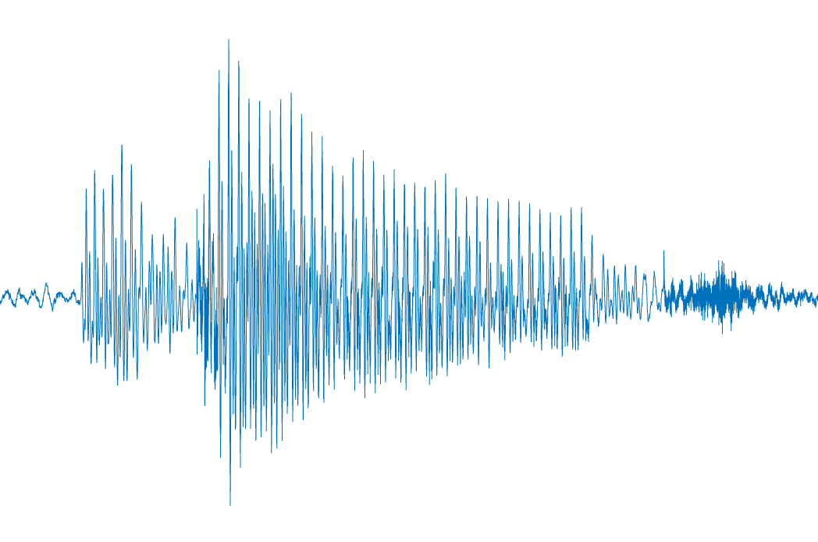
ready (0.5s)
stim (1.0s)
pause (1.0s)
ready (0.5s)
stim (1.0s)
pause (4.5, 5.5, or 6.5s)
+
BEEG
+
DEEJ

Slide 3
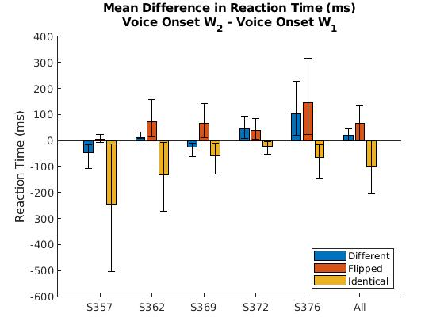
***
***
*
*
*
****
S357: | 0.000230
S362: | 0.000368
S369: | 0.013775
S372: | 0.039985
S376: | 0.047623
All: | 9.0209e-10
Notes:
Add stars for significance? Based on anova
Change y axis to reaction time difference (eqn on y axis)
X-axis add subject
Reorder all graphs to be Identical, Different, Flipped
Dotted line divider to separate all subjects
0.05, 0.01, 0.001, 0.0001

Slide 4
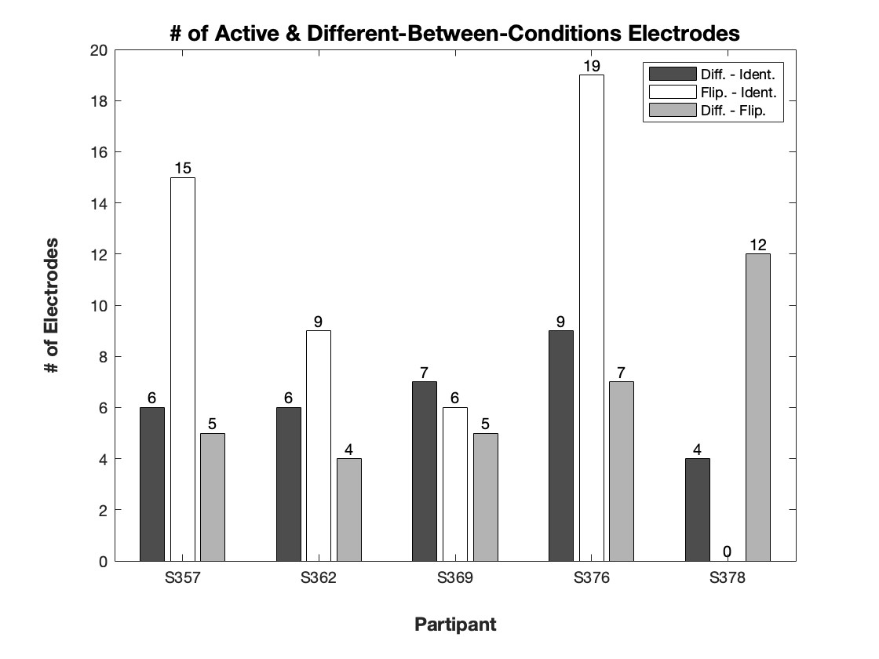
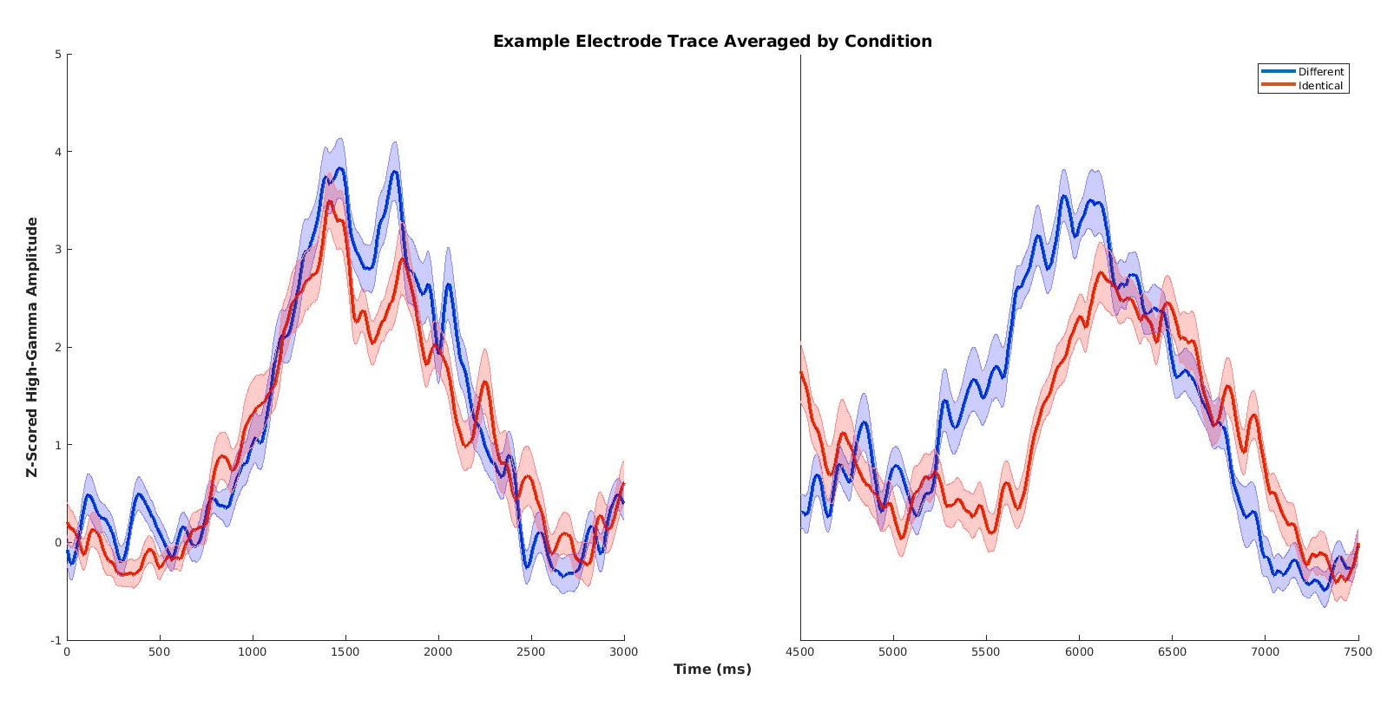
Notes:
Make figure only, combine all conds. Table to supplementary, brain with RS vs RE instead, example trace (responsive and RS and response and RE elec)
Table 3: Breakdown of the distribution of electrodes passing the permutation test and showing a significant difference between the identical and different conditions. The first column of data indicates the proportion of electrodes that showed a significant difference among the general population. The second column is the proportion of electrodes that were both significantly different between conditions and active amongst the general population. The final, rightmost column of data indicates the proportion of electrodes with a significant difference between conditions among the active electrode population.

Slide 5


Slide 6
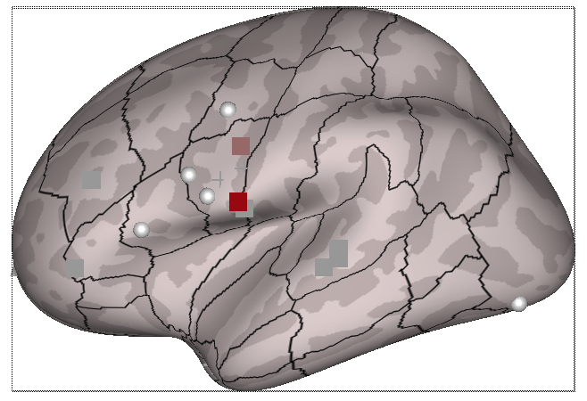
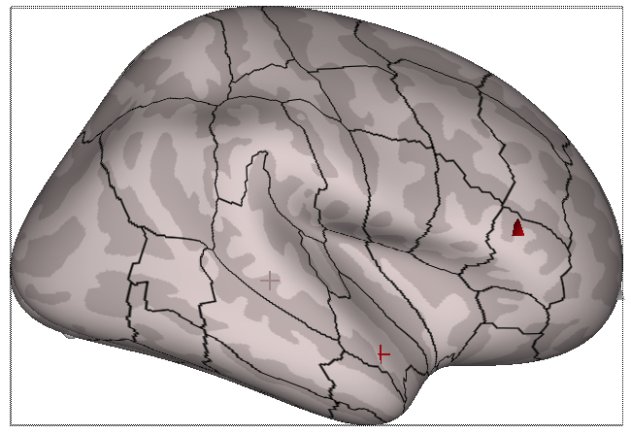
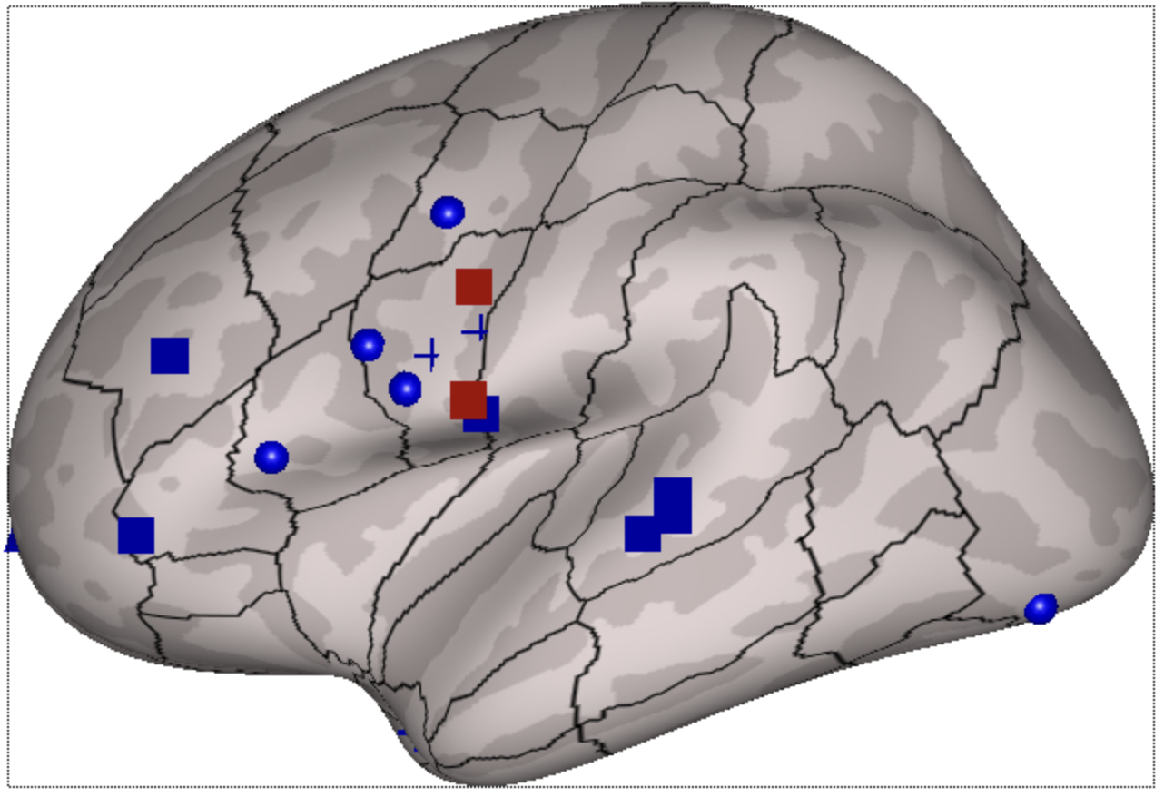
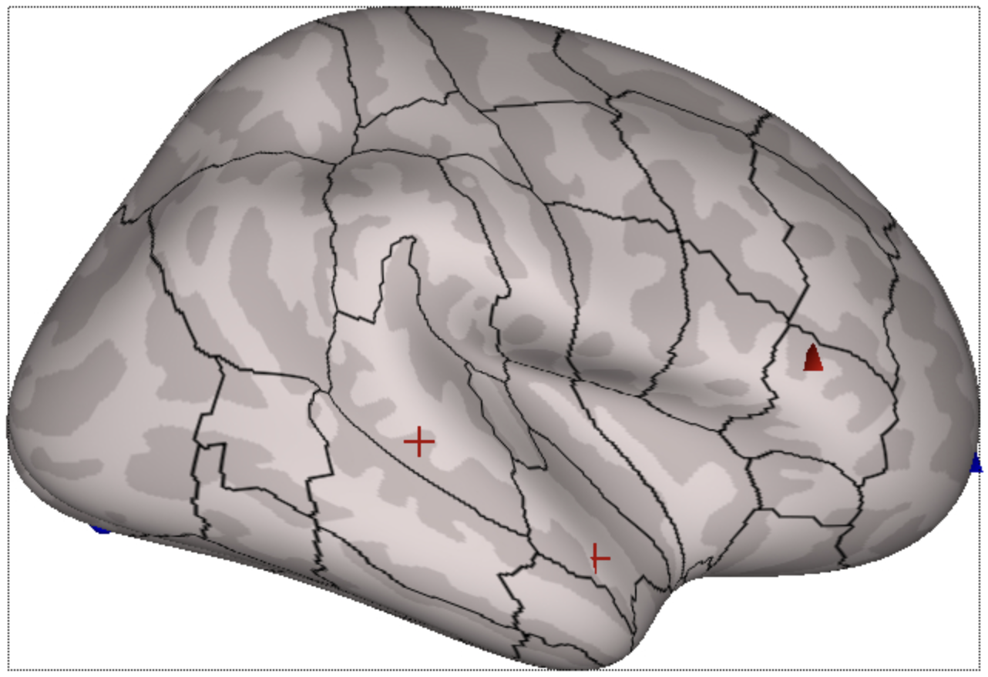
DI
Blue – Greater activity in Different
Red – Greater activity in Identical

Slide 7
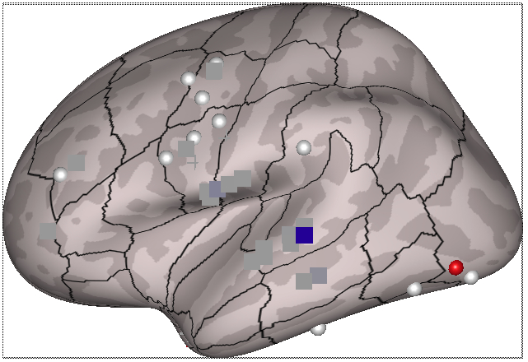
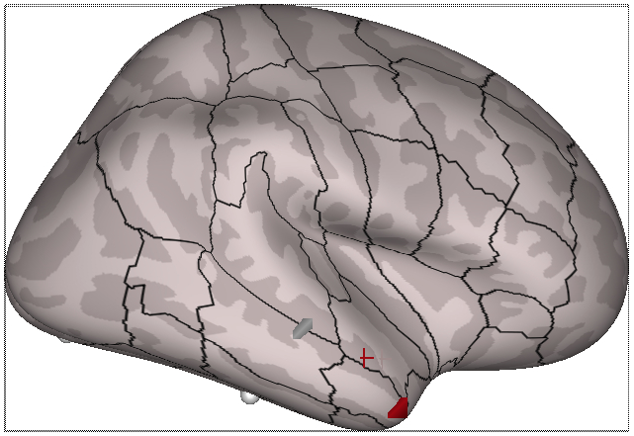
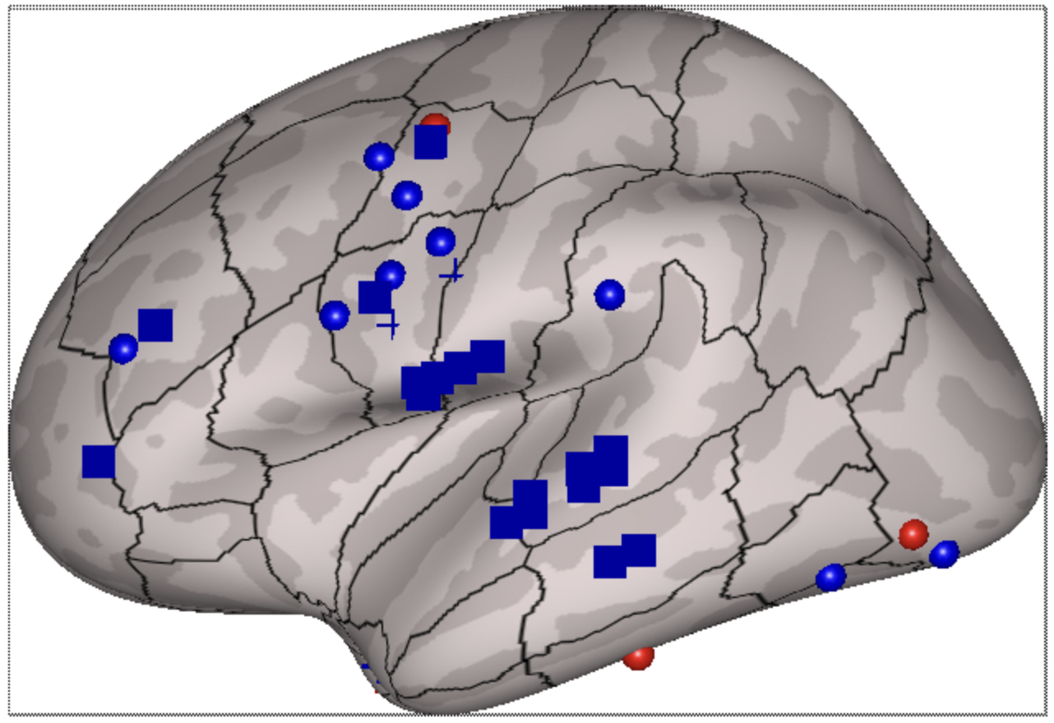
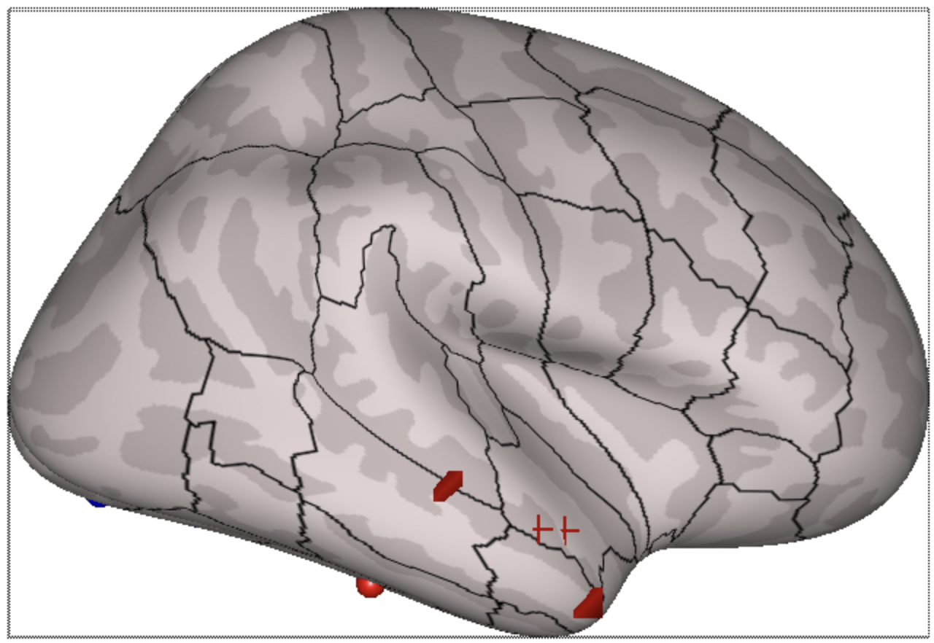
FI
Blue – Greater activity in Flipped
Red – Greater activity in Identical

Slide 8
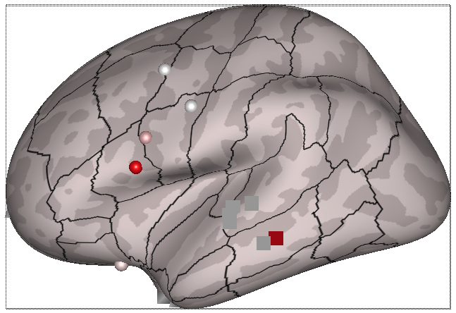
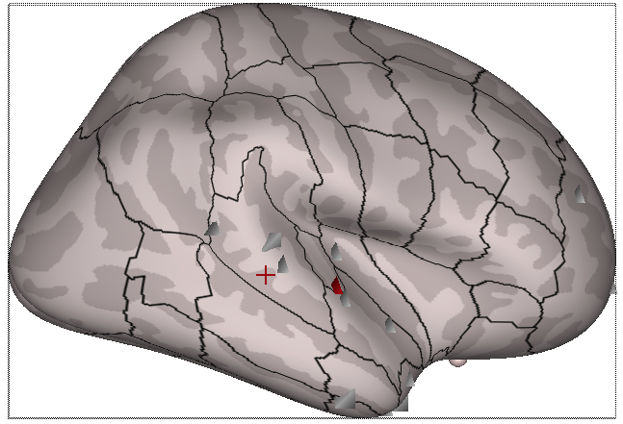
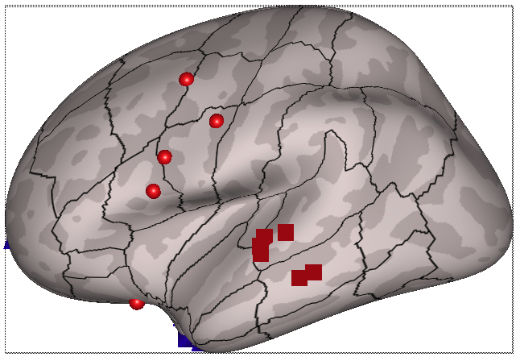
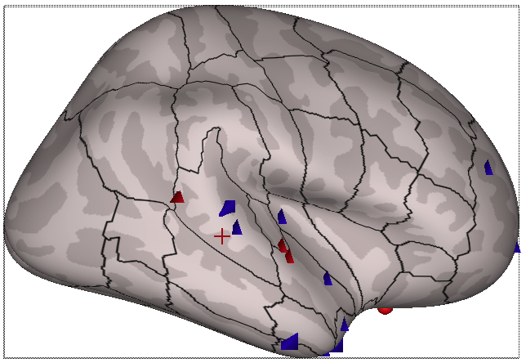
DF
Blue – Greater activity in Different
Red – Greater activity in Flipped

Slide 9
Supplemental Figures

Slide 10
Number of Significant Electrodes per Participant
 |  |  | Different - Identical |  |  |  | Flipped-Identical |  |  |  | Different-Flipped
Participant | Active/All Electrodes |  | DBC/All Electrodes |  | Active & DBC/All Electrodes |  | DBC/All Electrodes |  | Active & DBC/All Electrodes |  | DBC/All Electrodes |  | Active & DBC/All Electrodes
S357 (n=153) | 33 | (21.6%) | 11 | (7.2%) | 6 | (3.4%) | 25 | (16.3%) | 15 | (9.8%) | 13 | (8.5%) | 5 | (3.3%)
S362 (n=198) | 29 | (14.6%) | 12 | (6.1%) | 6 | (3.0%) | 27 | (13.6%) | 9 | (4.5%) | 15 | (7.6%) | 4 | (2.0%)
S369 (n=250) | 109 | (43.6%) | 15 | (6.0%) | 7 | (2.8%) | 13 | (5.2%) | 6 | (2.4%) | 6 | (2.4%) | 5 | (2.0%)
S372 (n=214) | 72 | (33.6%) | 17 | (7.9%) | 9 | (4.2%) | 30 | (14.0%) | 19 | (8.9%) | 21 | (9.8%) | 7 | (3.3%)
S376 (n=221) | 119 | (53.8%) | 7 | (3.2%) | 4 | (1.8%) | 2 | (0.9%) | 0 | (0.0%) | 17 | (7.7%) | 12 | (5.4%)
Total (n=1036) | 362 | (34.9%) | 62 | (6.0%) | 32 | (3.1%) | 97 | (9.4%) | 49 | (4.7%) | 72 | (6.9%) | 33 | (3.2%)
Notes:
Table 3: Breakdown of the distribution of electrodes passing the permutation test and showing a significant difference between the identical and different conditions. The first column of data indicates the proportion of electrodes that showed a significant difference among the general population. The second column is the proportion of electrodes that were both significantly different between conditions and active amongst the general population. The final, rightmost column of data indicates the proportion of electrodes with a significant difference between conditions among the active electrode population.

Slide 13
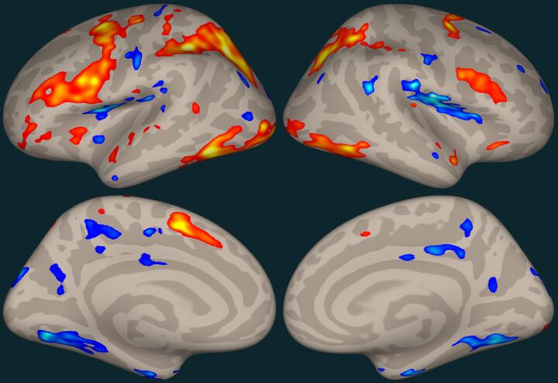
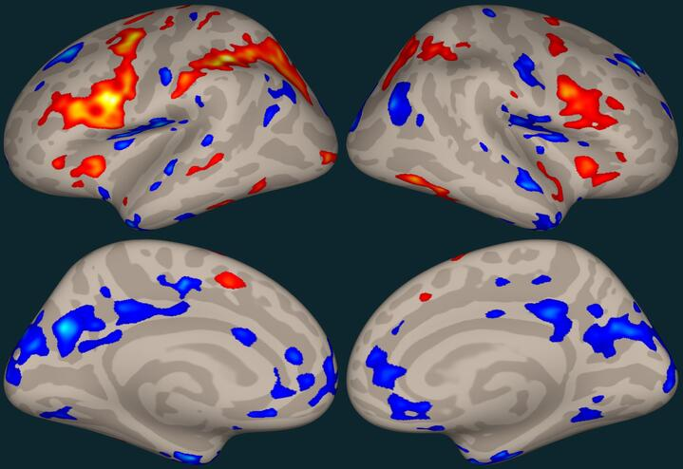
DDS-SSS [flip - iden]
DDS - DDD [flip - dif]

